Slide 1
Integrating the Schroedinger-Poisson equations on Quantum Computing devices
Giuseppe Murante

Slide 2
What is Quantum Computing?
Quantum computing is not like having a quantum accelerator in your CPU: it is another world
Information and elaboration are done at a quantum-mechanics level, creating a quantum wave function and modifying it to solve your problem
Qubits are the atomic objects of quantum computing
Results are intrinsically probabilistic. The resulting wavefunction must be reconstructed by repeating the computation many times (shoots) for sampling it
Not all problems are suitable for being solved with quantum computing. In particular nonlinear problems are difficult
In the future, often a combination of classical and quantum computation will probably be used (but not an accelerator… no compilers… no pragmas…)

Slide 3
Note that a qubit can represent one real number. With no digital truncation.
2D Hilbert space, unitary matrices operate on qubits, and operations are intrinsically linear

Slide 7
Dirac notation

Slide 8
Programming Quantum Computers
Qubits must be worked directly. No source code, no compilers An algorithm is realized via a serie of gates acting on qubits

Slide 9
Gates
Note that if the control qubit is superposed the result will be probabilistic!
ONE measure will return |0> or |1> !
…and many more…

Slide 10
Quantum advantage vs quantum supremacy…

Slide 11
algoritmi

Slide 12
Controlled rotations. Create entanglement
Quantum parallelism!

Slide 13
Quantum parallelism
Suppose you have a function that gives: f(0)=0.3, f(1)=0.6 and you want to evaluate it.
Classically you call f(0) and f(1)
With a quantum computer:
Rotate |0> so that its amplitude it 0.3
Now q0 is half |0>, half |1>
Now q0 is half |0>, half |1>
H
CR
R
q0
M
q1
Conditional rotation:
If q0 is |1> rotate q1 so that the squared amplitude of its |0> is 0.6
MEASURE q1 You get amplitudes 0.3 for |0> [f(q0)] and 0.6 for |0> of q1 [f(q1)]. ONE call
Initialized to |0>
You can repeat this trick with how many qubits you want!!!

Slide 15
Infancy of Quantum Computing
Only few qbits available on physical devices (IBM: 127 qubits; NASA/Google, 72)
Not all gates available, they must be emulated (transpiling)
No quantum memory exists. Data must be loaded all the times (and it’s painful)
Relatively few quantum algorithms exist.

Slide 16
Properties of quantum computations
Shoots: the measure must be repeated many times to sample the wavefunction (remember that a measure will make it collapse)
Noise: when implementing a circuit, a random gate could be added!
Circuit depth: entangling is a fundamental property of quantum computing, but it is subject to decoherence. It is not possible to make circuit of arbitrary complexity.
Emulation: many (actually, the great majority of) quantum algorithms are produced and tested on emulators. Pros: you can have full info on your wavefunction. Cons: it’s not the real thing.
Current almost-real application: cyber-security, cryptography, machine learning, finance…
QC is in its infancy but the baby is very promising

Slide 17
From Wikipedia: what is a real quantum computer?
Candidates for physical realizations
For physically implementing a quantum computer, many different candidates are being pursued, among them (distinguished by the physical system used to realize the qubits):
Superconducting quantum computing[79][80] (qubit implemented by the state of small superconducting circuits [Josephson junctions])
Trapped ion quantum computer (qubit implemented by the internal state of trapped ions)
Neutral atoms in optical lattices (qubit implemented by internal states of neutral atoms trapped in an optical lattice)[81][82]
Quantum dot computer, spin-based (e.g. the Loss-DiVincenzo quantum computer[83]) (qubit given by the spin states of trapped electrons)
Quantum dot computer, spatial-based (qubit given by electron position in double quantum dot)[84]
Quantum computing using engineered quantum wells, which could in principle enable the construction of quantum computers that operate at room temperature[85][86]
Coupled quantum wire (qubit implemented by a pair of quantum wires coupled by a quantum point contact)[87][88][89]
Nuclear magnetic resonance quantum computer (NMRQC) implemented with the nuclear magnetic resonance of molecules in solution, where qubits are provided by nuclear spins within the dissolved molecule and probed with radio waves
Solid-state NMR Kane quantum computers (qubit realized by the nuclear spin state of phosphorus donors in silicon)
Electrons-on-helium quantum computers (qubit is the electron spin)
Cavity quantum electrodynamics (CQED) (qubit provided by the internal state of trapped atoms coupled to high-finesse cavities)
Molecular magnet[90] (qubit given by spin states)
Fullerene-based ESR quantum computer (qubit based on the electronic spin of atoms or molecules encased in fullerenes)[91]
Nonlinear optical quantum computer (qubits realized by processing states of different modes of light through both linear and nonlinear elements)[92][93]
Linear optical quantum computer (qubits realized by processing states of different modes of light through linear elements e.g. mirrors, beam splitters and phase shifters)[94]
Diamond-based quantum computer[95][96][97] (qubit realized by the electronic or nuclear spin of nitrogen-vacancy centers in diamond)
Bose-Einstein condensate-based quantum computer[98]
Transistor-based quantum computer – string quantum computers with entrainment of positive holes using an electrostatic trap
Rare-earth-metal-ion-doped inorganic crystal based quantum computers[99][100] (qubit realized by the internal electronic state of dopants in optical fibers)
Metallic-like carbon nanospheres-based quantum computers[101]
The large number of candidates demonstrates that quantum computing, despite rapid progress, is still in its infancy.

Slide 18
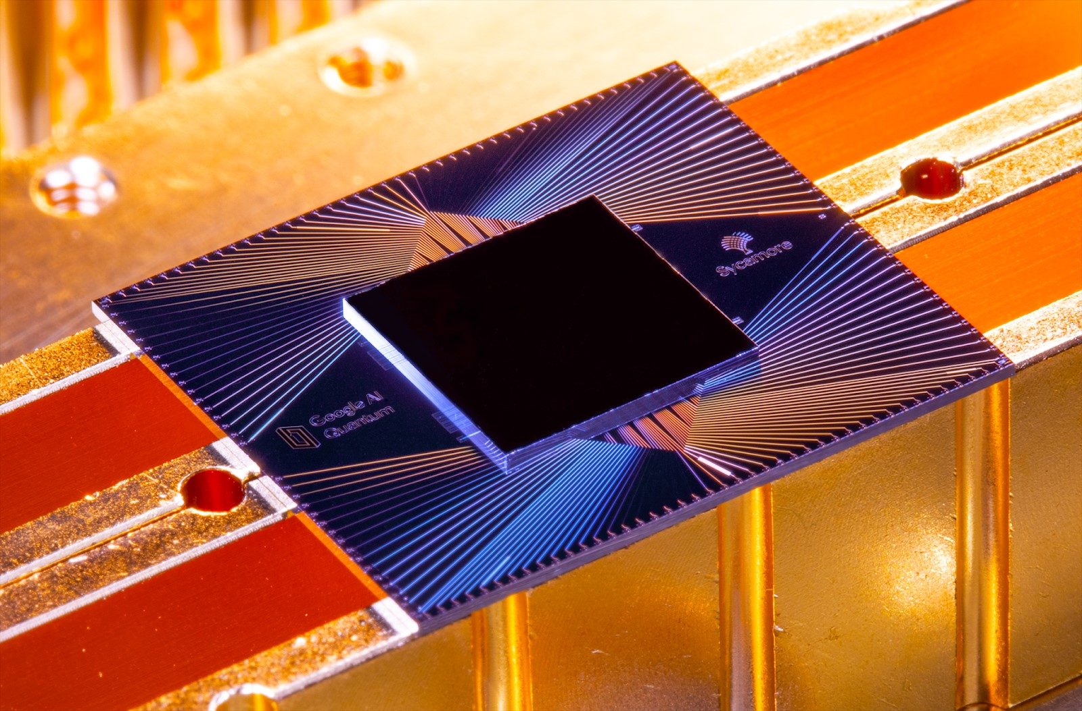
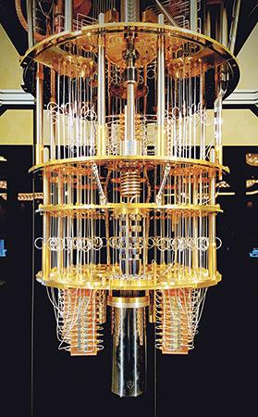
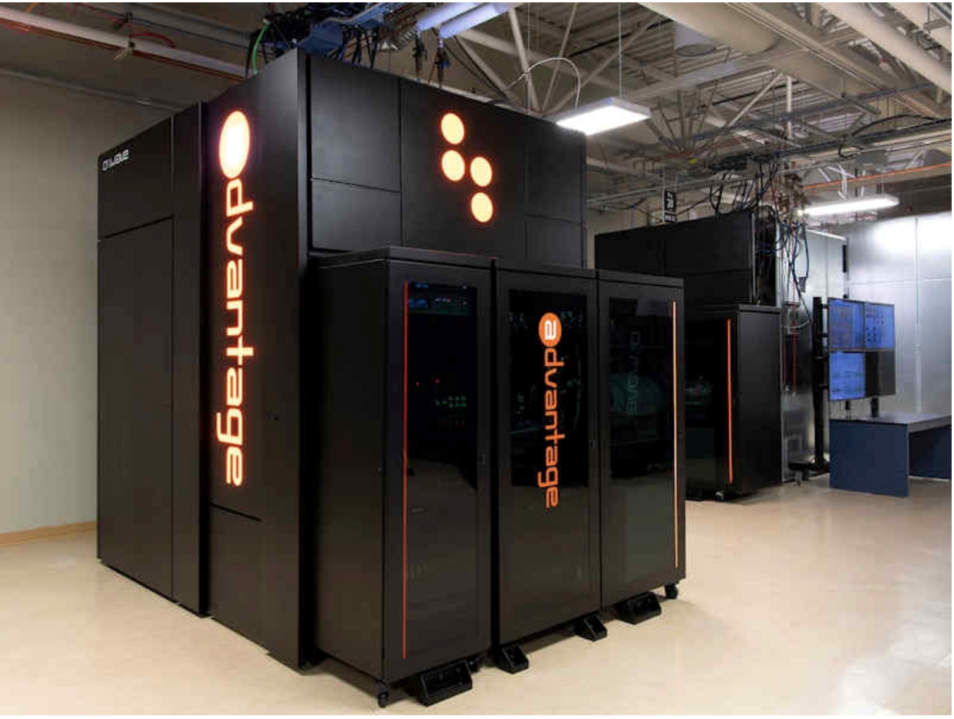

Slide 19
A case study for astrophysics: Schroedinger-Poisson equations
Reduced equations
Full equations
Becomes Euler-Poisson when m tends to infinite
Quantum potential
Nonlocal quantum pressure tensor

Slide 20
Cost function (to be minimized with QC):
Authors claim exponential speedup

Slide 21
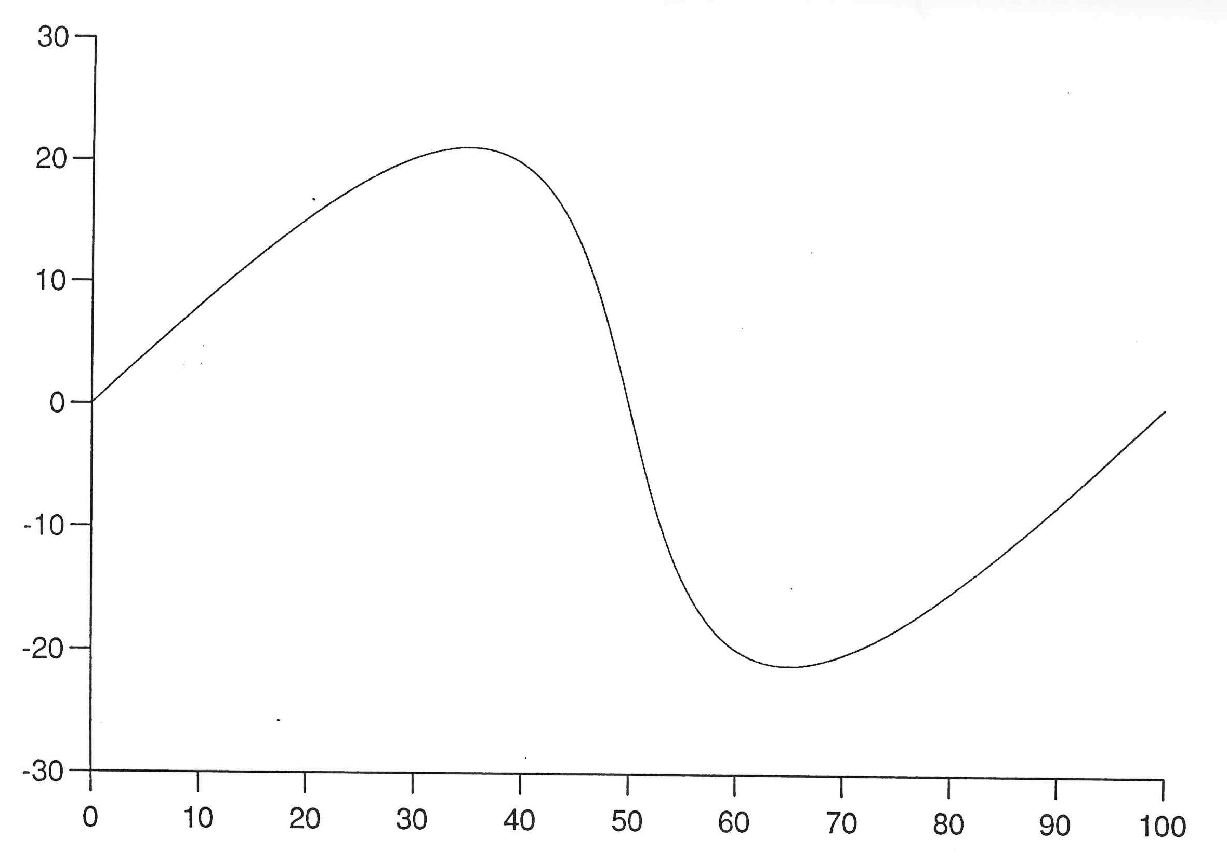
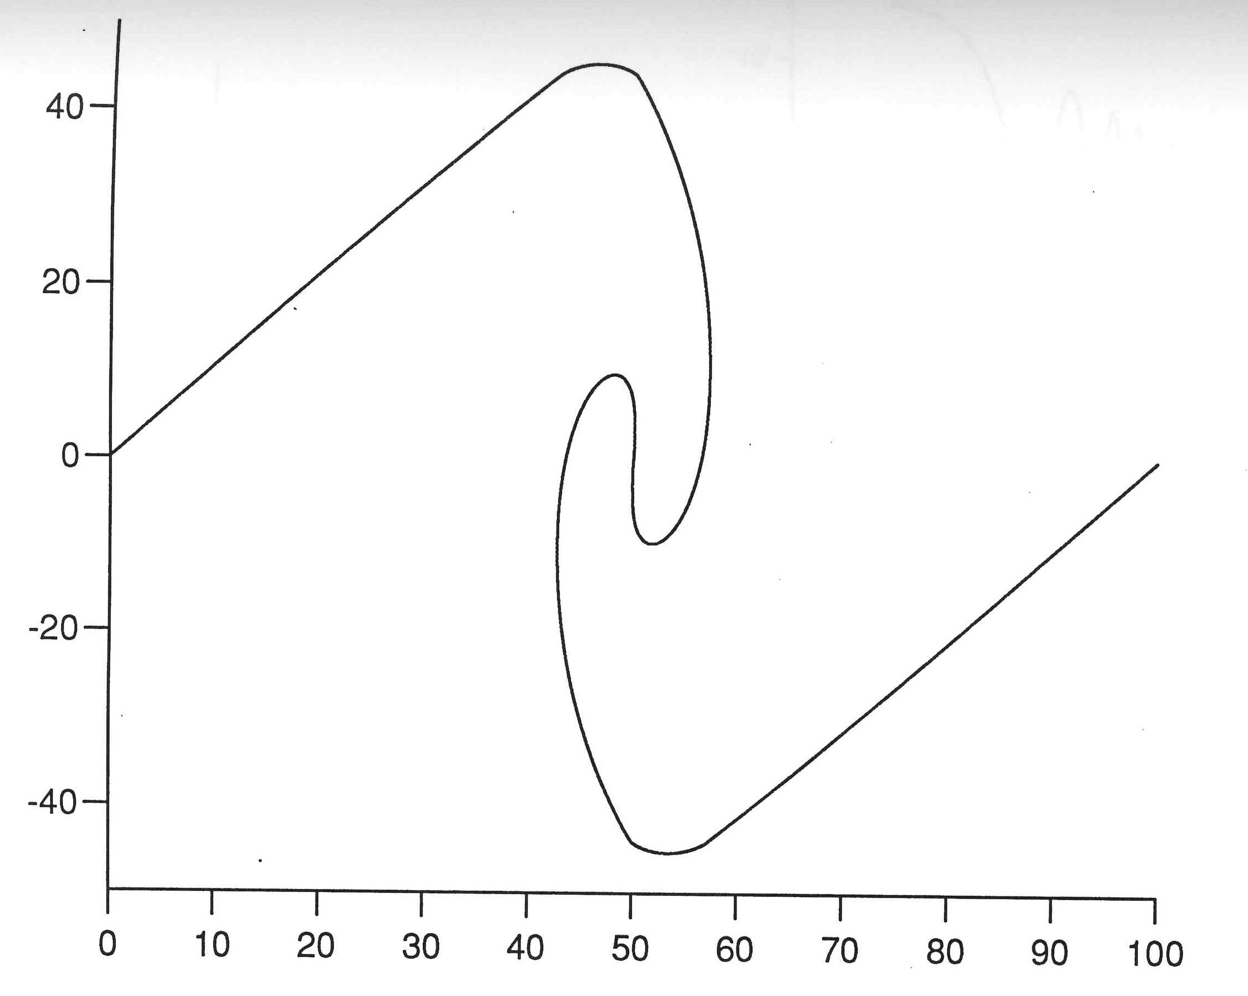
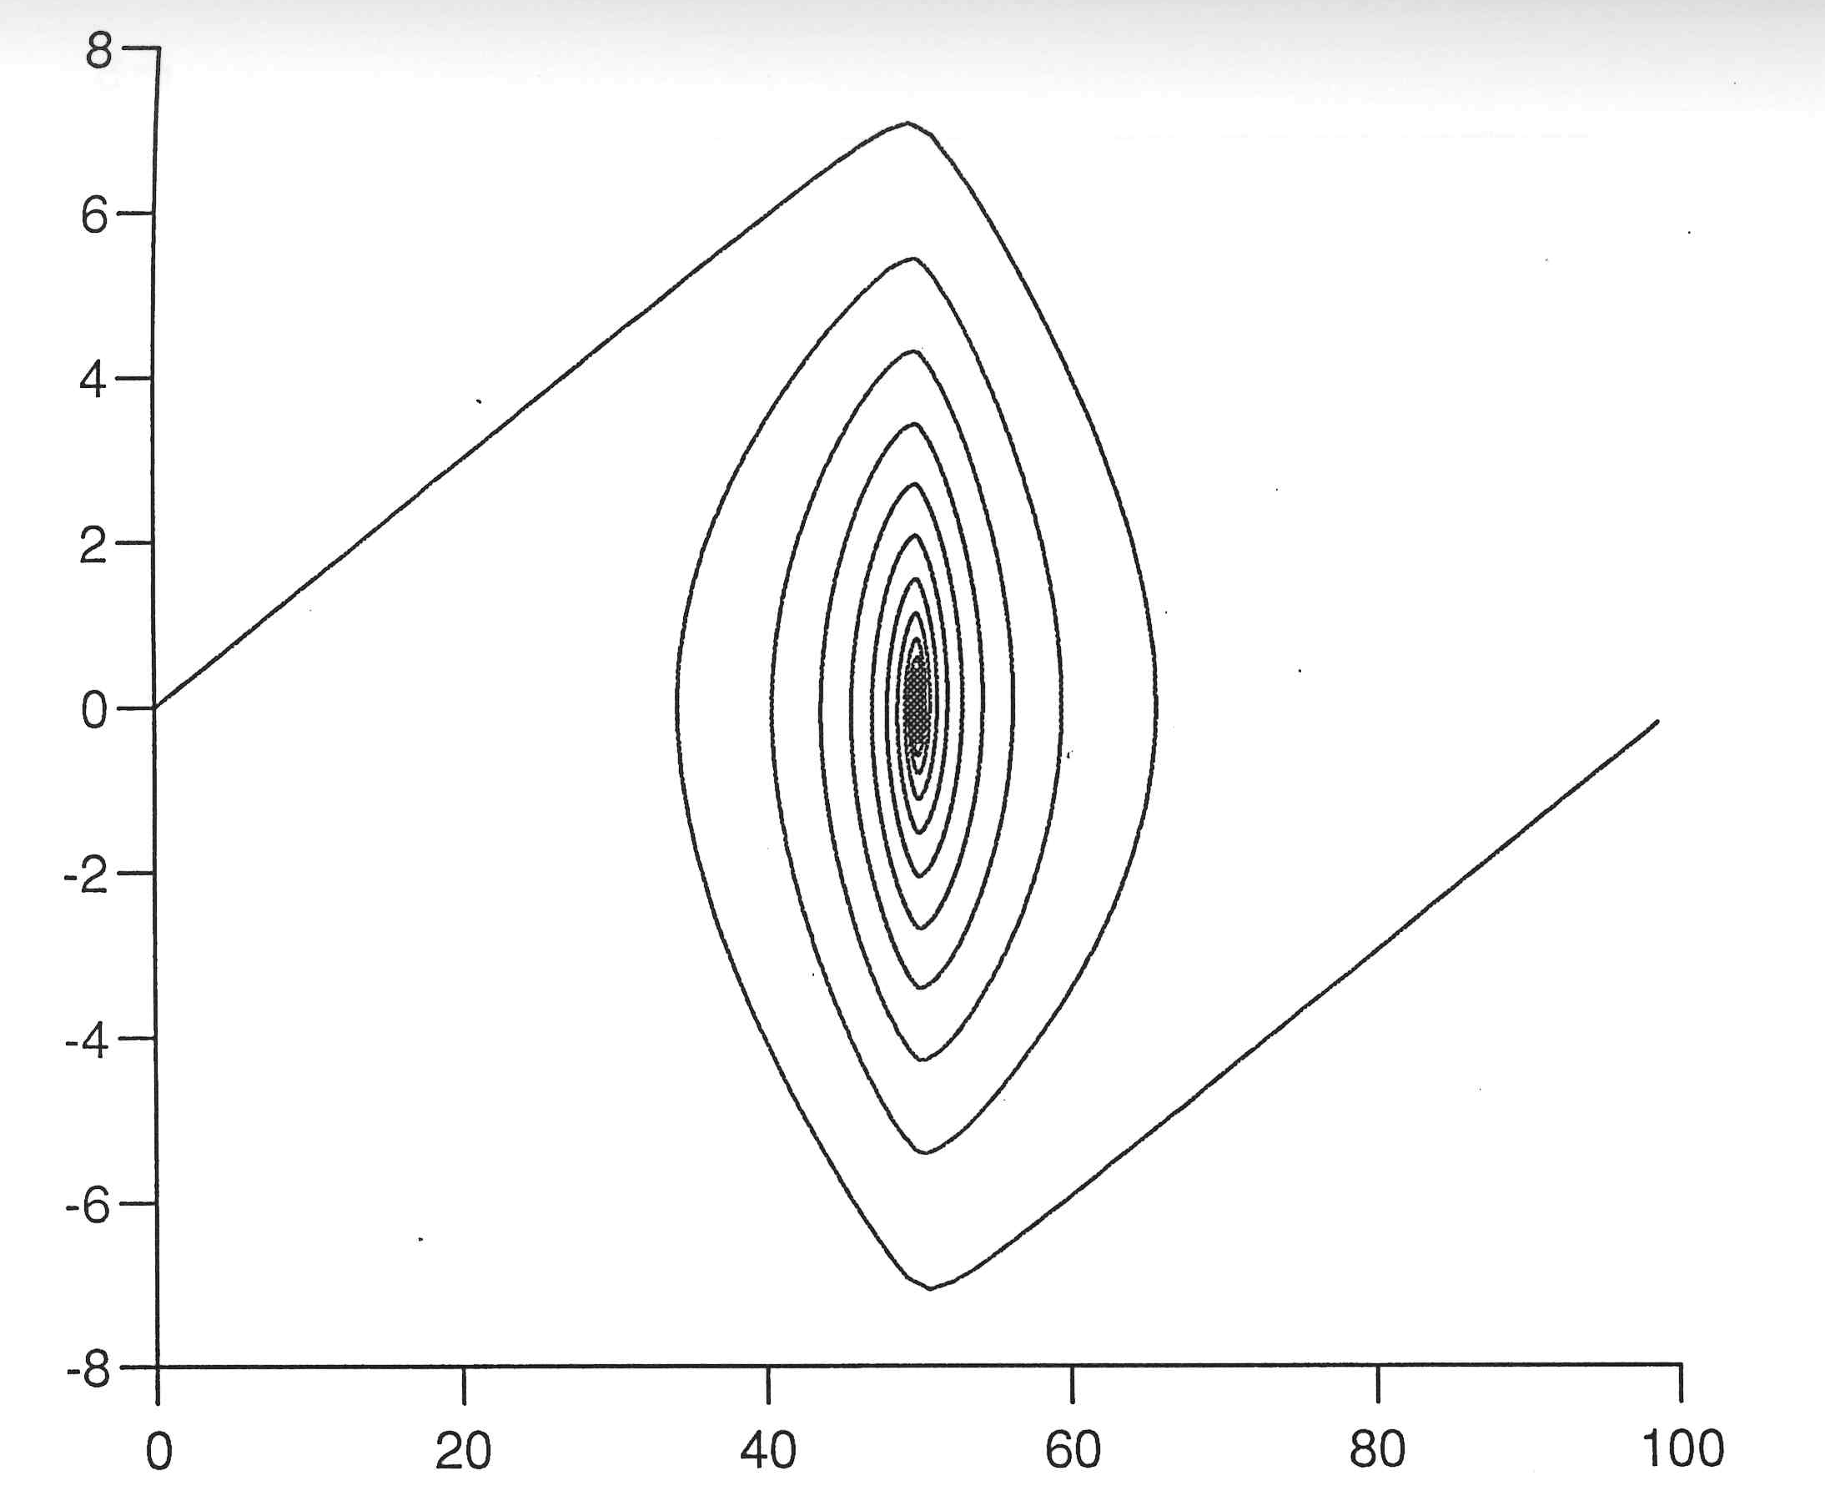
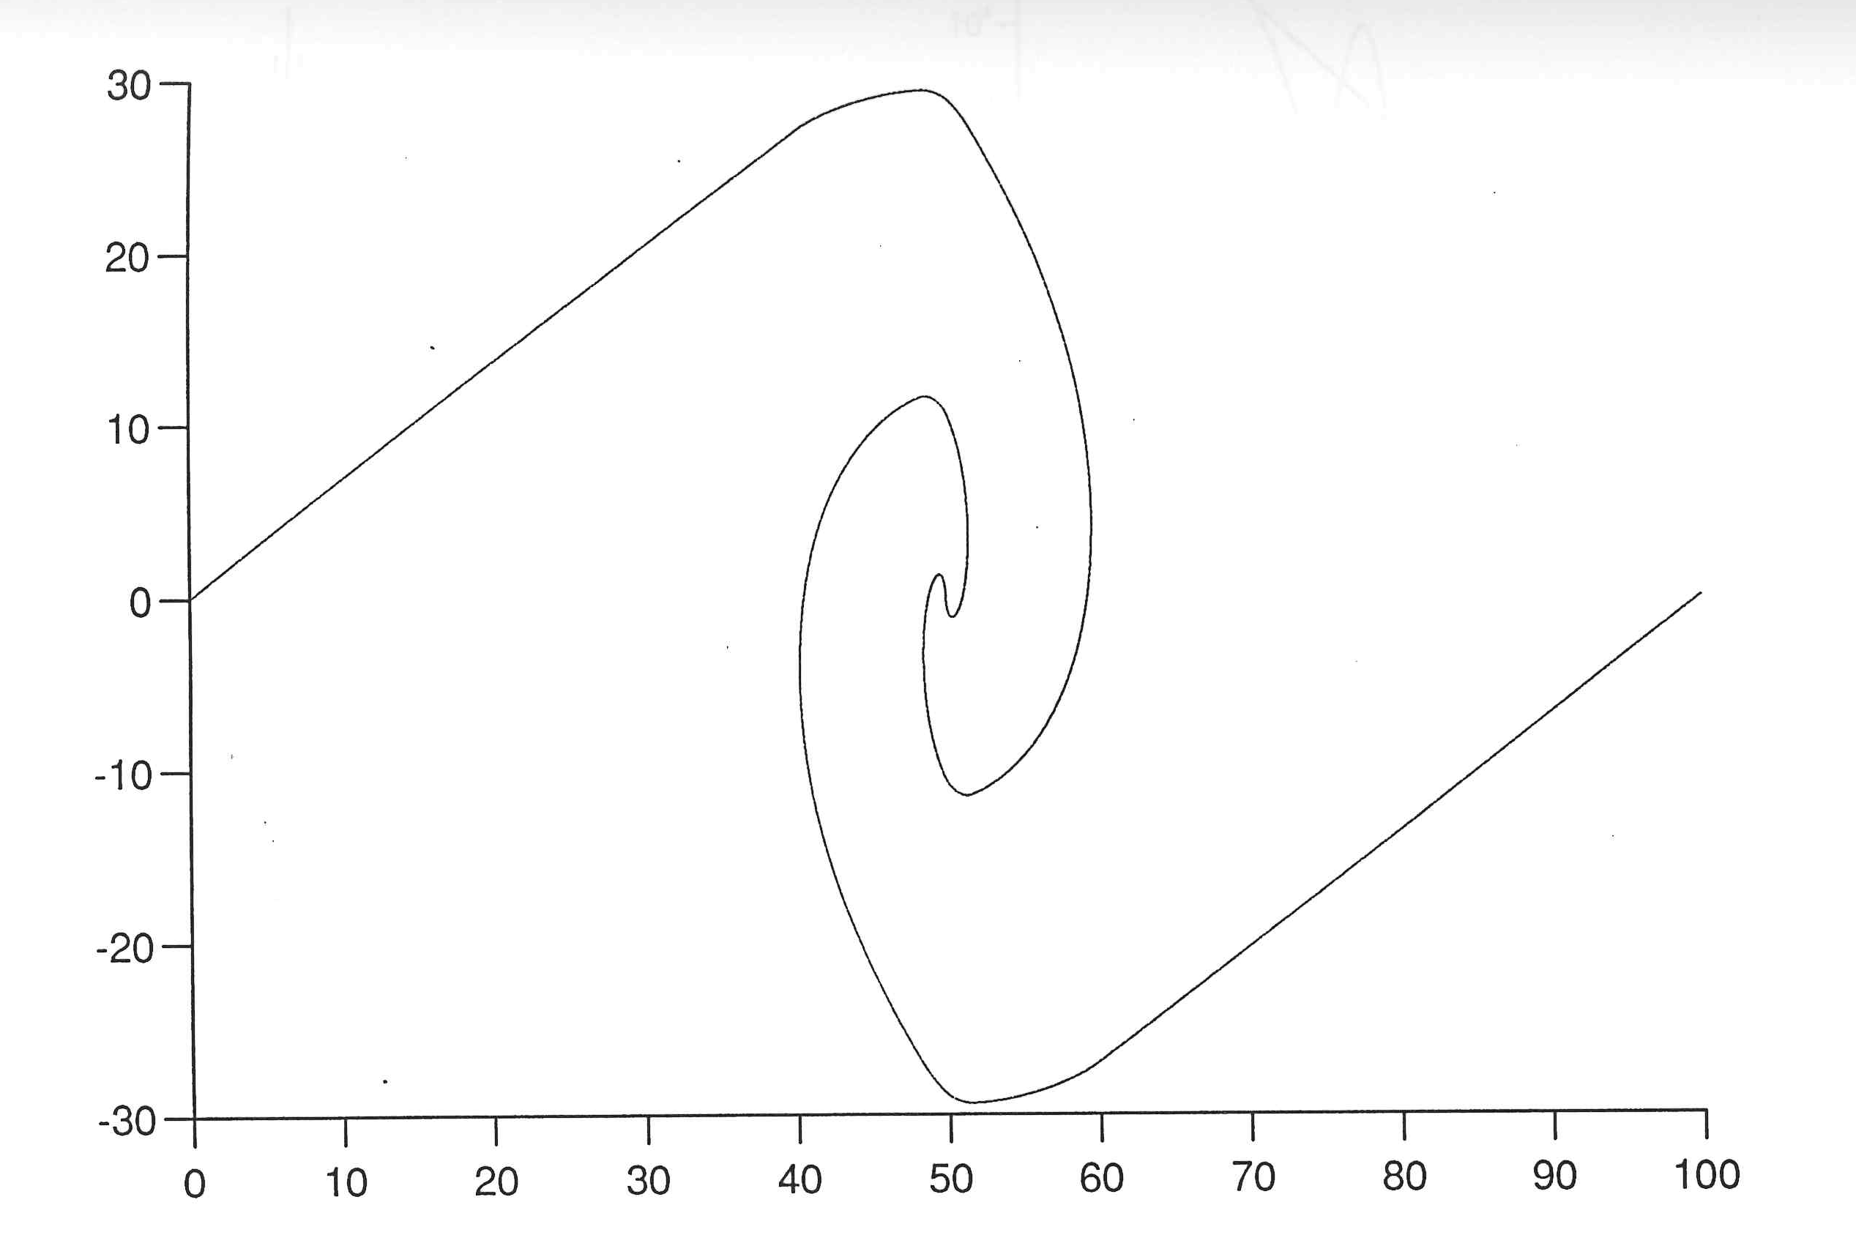
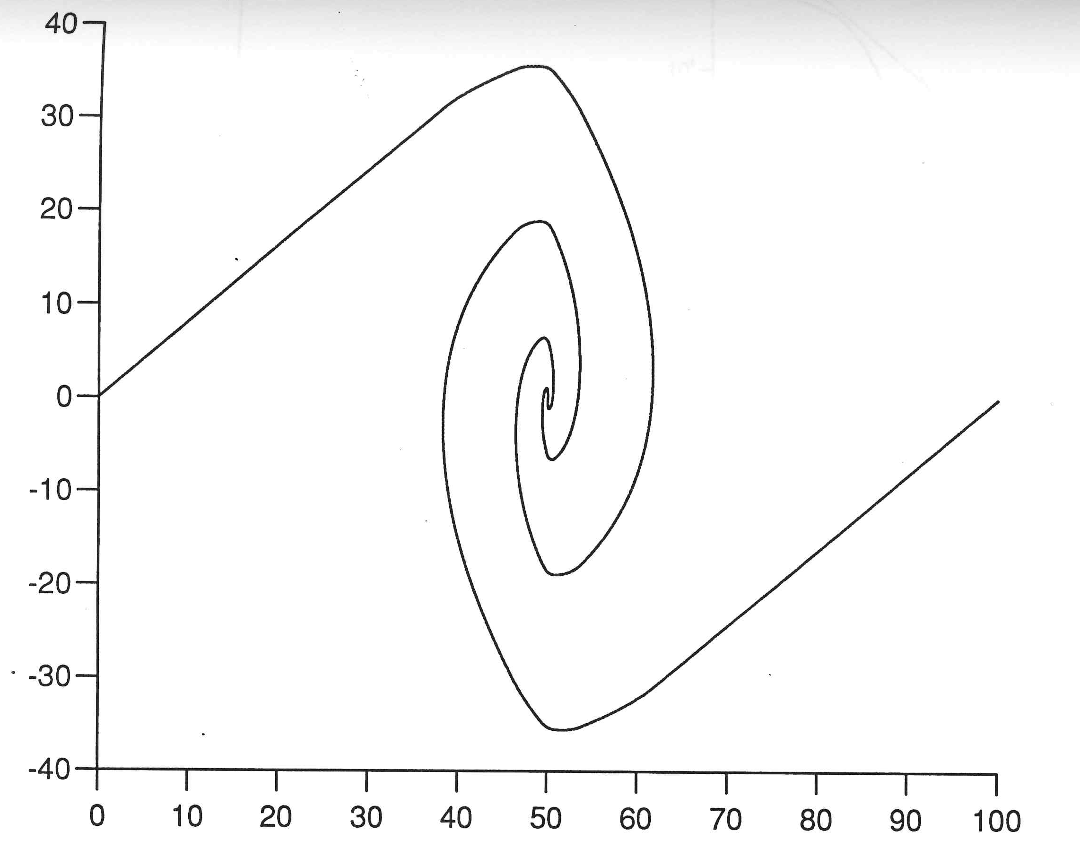
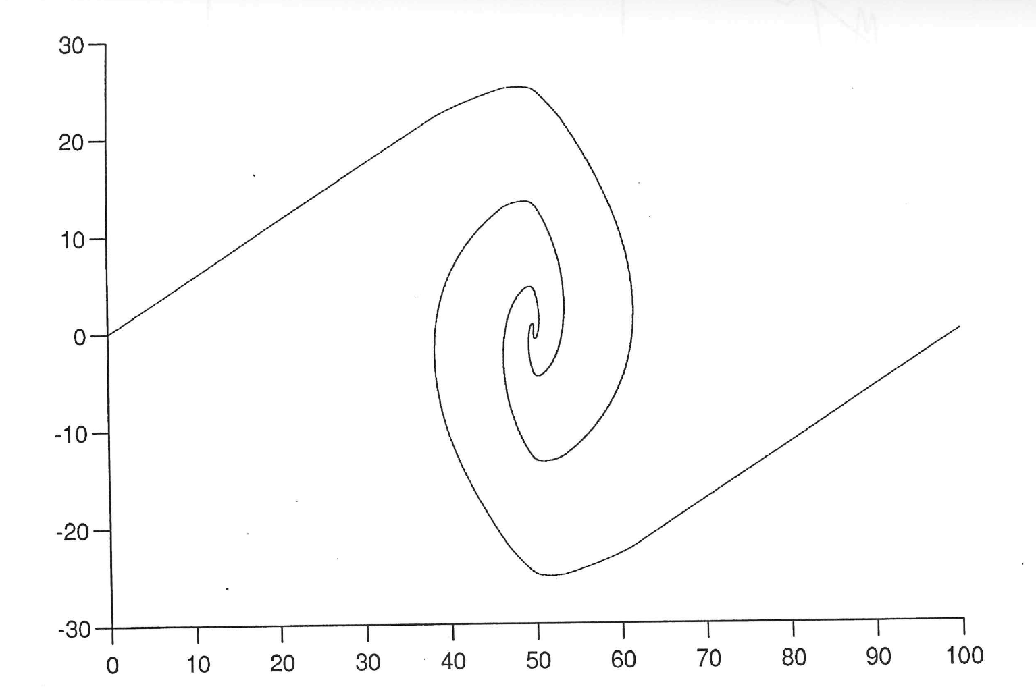
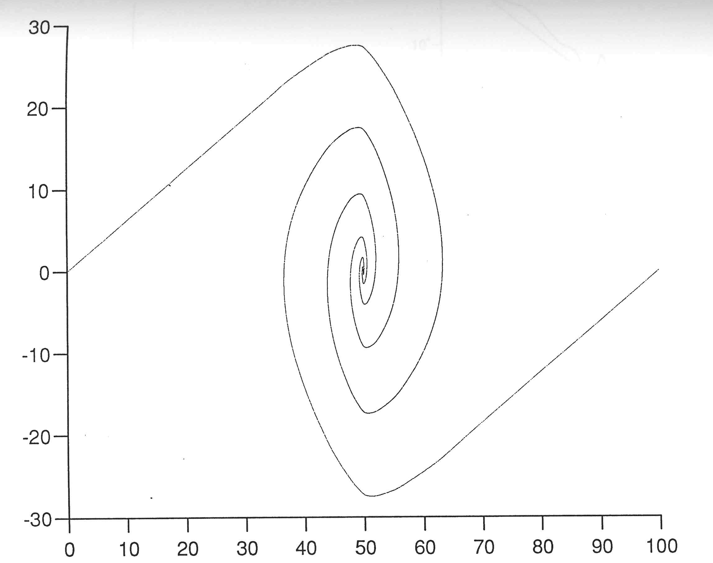
Classical evolution of 1D gravity

Slide 22
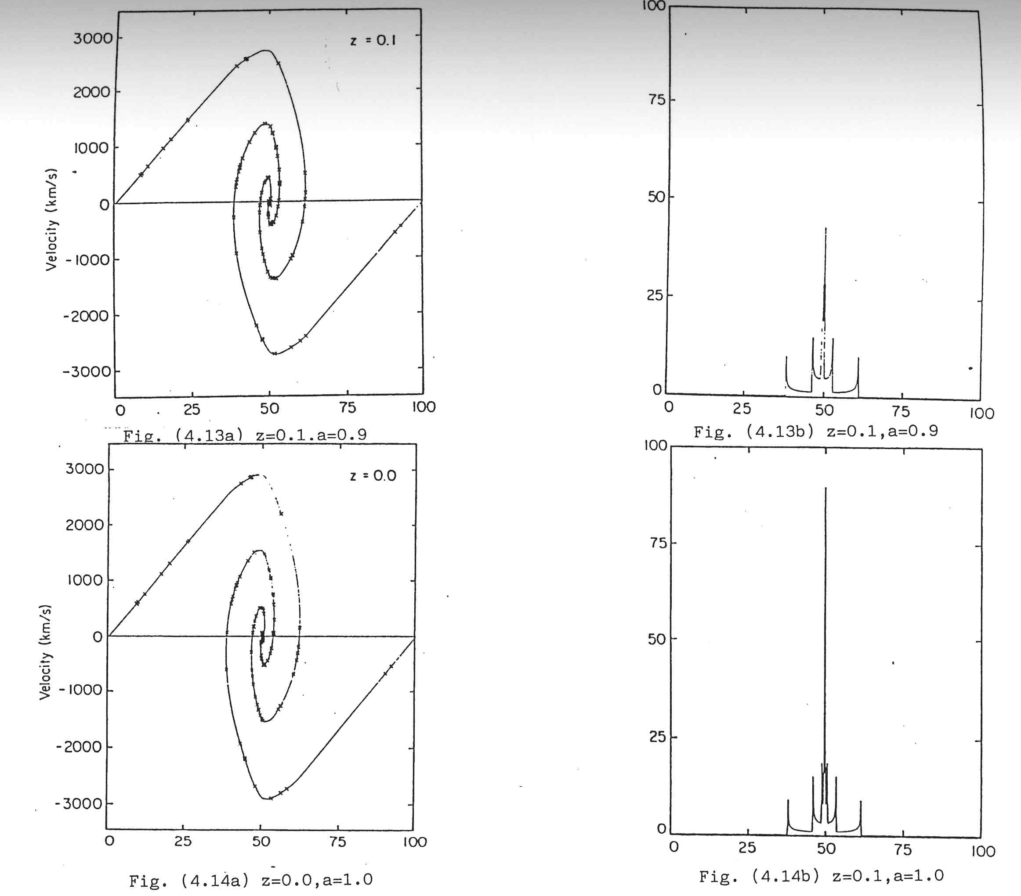

Slide 23
Results from Mocz & Szasz

Slide 24
A step forward
Test Mocs & Szasz ansatz
Calculating scaling behaviours and errors
Implementing on a true quantum computer!!
In collaboration with IBM

Slide 25

Thank you.
Questions?
Comments?

Slide 26

Schroedinger’s cat
I am alive.
And I am coming for you

